Slide 1

TEAM MEMBERS
AVALA TEJASWINI
BALAGA LOKESH KUMAR
BURALA DIWAKAR
GUDIYA HARINAD SAHU
VANDANA RAJA KUMAR

Slide 2
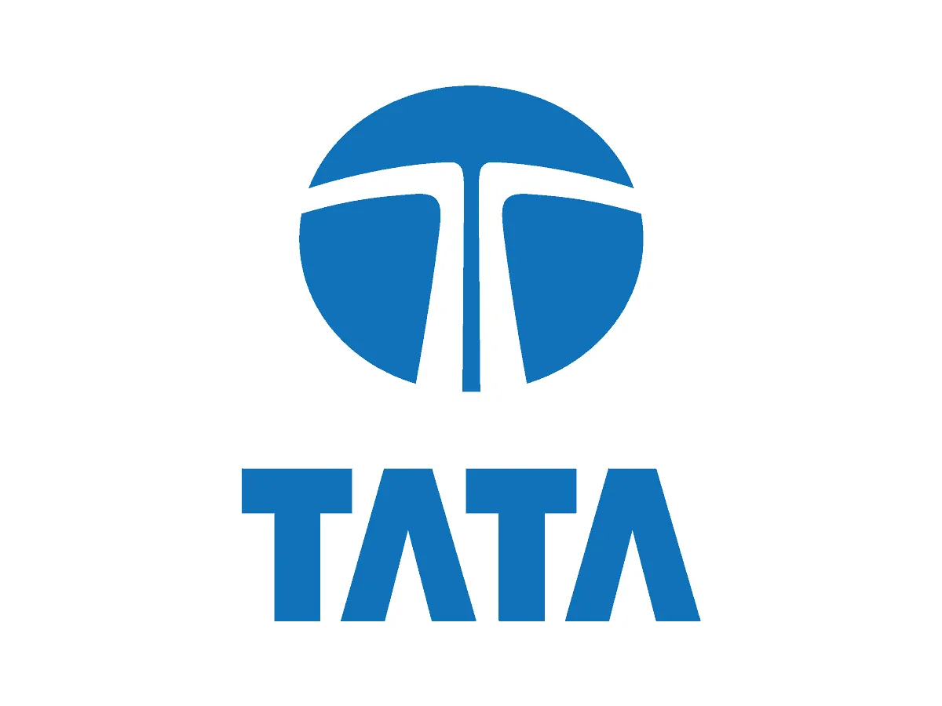
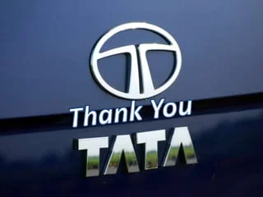
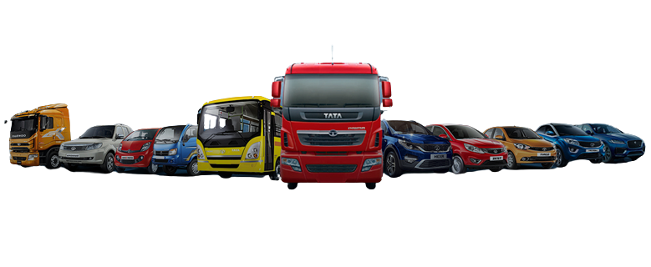
Introduction to Tata Motors
Tata Motors is an Indian multinational automotive manufacturing company.
It is a part of the Tata Group, one of India's largest conglomerates.
Tata Motors is headquartered in Mumbai, Maharashtra, India.
Notes:
Image source: https://indianauto.com/news/tata-motors-sale-chinese-nid6737

Slide 3
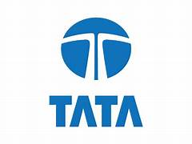
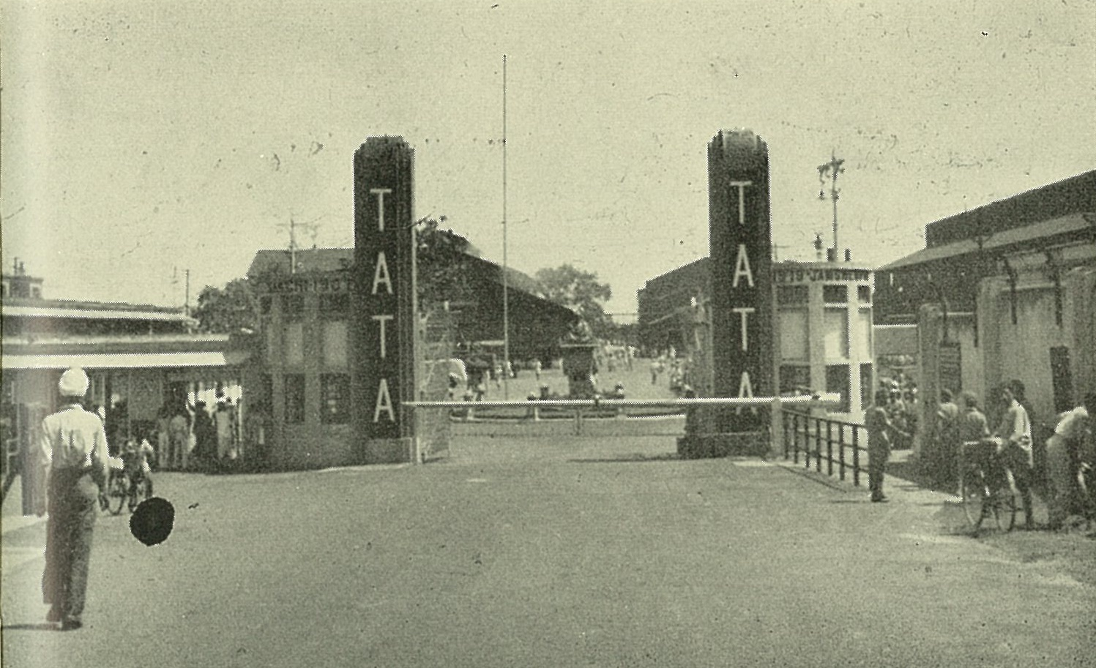
History and Background
Tata Motors was founded in 1945 as Tata Engineering and Locomotive Co. Ltd. (TELCO).
It started as a manufacturer of locomotives and later diversified into commercial vehicles and passenger cars.
In 2008, Tata Motors acquired Jaguar Land Rover, a British luxury car manufacturer.
Notes:
Image source: https://bharathautos.com/2014-tata-motors-60-years-truck-manufacturing-jamshedpur.html

Slide 4
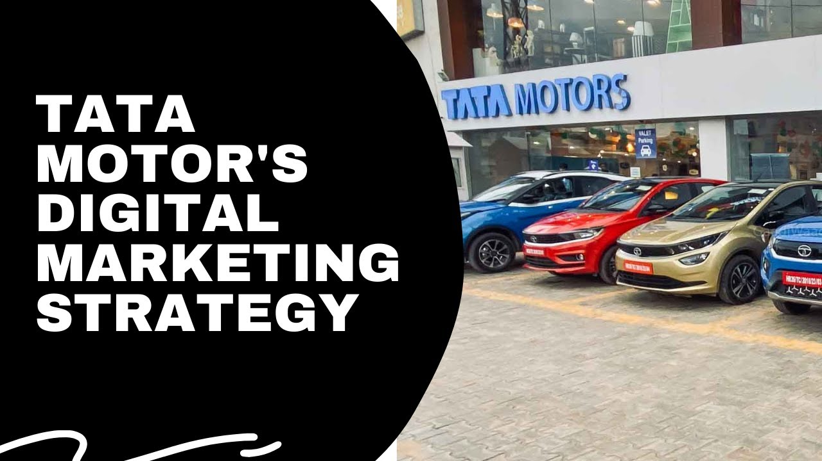
Digital marketing
Tata Motors is one of India’s largest automobile manufacturers. Over the years, the company has become a well-known brand not only in India but also globally.
The company has been successful in establishing a strong presence in the domestic market and expanding its reach in international markets.
The automobile industry is highly competitive, and to stay ahead, companies need to have a strong marketing strategy.
In this in-depth case study, we will analyze Tata Motors’ marketing strategies and how they have helped the company succeed in a highly competitive market.
We will take a closer look at the company’s branding, digital marketing, and social media strategies, as well as its efforts to target new customers and expand into new markets.
Notes:
Image source: https://surenews.org/tata-motors-announces-price-hike-across-its-entire-passenger-vehicle-range/

Slide 5

1.Tata Motors:- Social media marketing strategies
The company uses social media to promote its brand values and share glimpses of how they contribute to the local community. They also discuss important issues and discuss the issue including gender equality, malnutrition, sanitation, and clean water, as well as other topics.
FACE BOOK STRATEGIES
INSTAGRAM STRATEGIES
TWITTER STRATEGIES
2.Tata Motors: Website Design
Tata Group’s website Tata Group has a user-friendly website filled with intriguing content that draws a significant readership regularly.
3.Tata Motor’s Paid Marketing Strategies
a)Facebook and Instagram Ads
b)Google Ads

Slide 6
COMPANY BRAND
Tata Motors is an Indian multinational automotive manufacturing company and a member of the Tata Group. It is one of the largest automobile manufacturers in India and has a global presence.
Tata Motors is known for producing a wide range of vehicles, including cars, trucks, buses, and commercial vehicles. They have a reputation for their affordable and durable vehicles, and they are known for their innovation in electric and sustainable transportation solutions.
Some of their popular car models include the Tata Indica, Tata Nano, Tata Tiago, and Tata Harrier. The company has a strong presence in both the Indian and international automotive markets.
Notes:
Image source: https://www.pinterest.jp/pin/tata-motors-global-presence-in-2022--871587334107884985/

Slide 7
COMPANY STRATEGIES
→ Tata Motors, an Indian automotive company, has employed various strategies over the years
Global Expansion*: Tata Motors aimed to expand its global presence. They acquired Jaguar Land Rover (JLR) in 2008, which provided access to premium markets.
Product Diversification*: They focused on a diverse product portfolio, including passenger cars, commercial vehicles, and electric vehicles, catering to different market segments.
Innovation and Technology*: Tata Motors invested in research and development, particularly in electric and connected vehicles. Their electric car, the Tata Nexon EV, is an example of this.
Sustainability*: Like many automakers, Tata Motors was increasingly focused on sustainability and reducing emissions. This included the development of electric and hybrid vehicles.
Cost Optimization*: They aimed to improve cost-efficiency through various means, including streamlining operations and supply chain management.
Market Localization*: In various regions, they adapted their products to meet local preferences and regulations.
Notes:
Image source: https://www.merisarkar.com/business-news/tiago-ev-tata-motors-launches-one-of-the-most-affordable-electric-cars-in-india/4043/

Slide 8
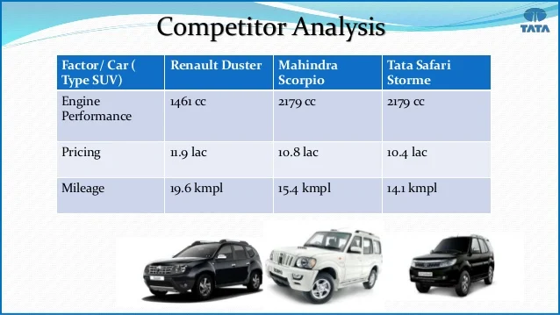
TATA MOTORS THEIR BRAND STRATEGIES
Tata Motors has employed various brand strategies to position itself
Innovation: Tata Motors has focused on innovation, particularly in the development of electric and eco-friendly vehicles. Their electric car, the Tata Nexon EV, is an example of this commitment to innovation
Value for Money: Tata Motors has positioned itself as a brand that offers value for money. They have focused on providing affordable and reliable vehicles, making them accessible to a broader consumer base.
Social Responsibility: Tata Motors has emphasized its commitment to corporate social responsibility and sustainability. This strategy aligns with changing consumer preferences for environmentally friendly and socially responsible brands
Quality Improvement: Over the years, Tata Motors has made efforts to improve the quality and reliability of their vehicles, which has positively impacted their brand perception.It's important to note that brand strategies can evolve over time, so Tata Motors' approach may have changed since my last knowledge update in September 2021.
.
Notes:
Image source: https://www.tatamotors.com/press/tata-motors-named-amongst-the-sustainability-leaders-in-global-automobile-industry-on-dow-jones-sustainability-index-djsi-2018/

Slide 9
MARKETING SHARES OF TATA MOTORS
The market shares of a company of Tata Motors, you would typically need to go through
Open a Demat Account: You'll need a Demat (Dematerialized) account to hold your shares in electronic form
Choose a Stockbroker: Select a reputable stockbroker or use an online trading platform to facilitate the buying and selling of Tata Motors shares.
Place an Order: Once you have an account, you can place buy or sell orders for Tata Motors shares, specifying the quantity and price at which you want to trade.
Market or Limit Orders: You can place market orders (buy/sell at the current market price) or limit orders (buy/sell at a specific price).
Monitor the Market: Keep an eye on the stock's performance, news, and market conditions to make informed decisions.
Notes:
Image source: https://www.tatasteel.com/media/newsroom/press-releases/india/2019/tata-steelium-honoured-with-the-cii-award-for-customer-centricity-2019/

Slide 10
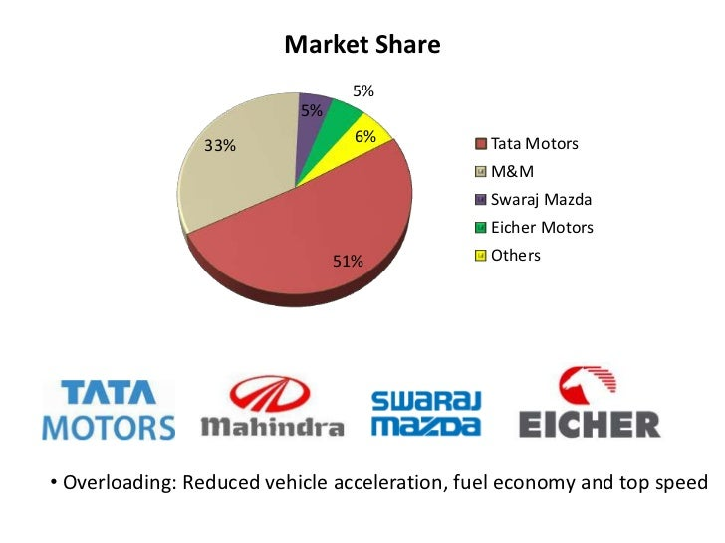
Transaction Settlement: When your order is executed, the shares will be credited to your Demat account, and the funds will be debited or credited accordingly.
7. Keep Records: Maintain records of your transactions for tax and accounting purposes.

Slide 11

SEO AND KEYWORDS RESEARCH OF TATA MOTORS
(SEO) for Tata Motors, like any other company, involves optimizing their online presence to improve visibility in search engine results. Here are some general SEO strategies they might consider:
*Keyword Research*
*On-Page SEO*
*Mobile Optimization*
*Quality Content*
*Local SEO.
*Technical SEO*:
*Backlink Building*
*Social Media*
*User Experience*
Notes:
Image source: https://joanalopesart.blogspot.com/2021/07/tatamotors-share-price-hometata-motors.html

Slide 12

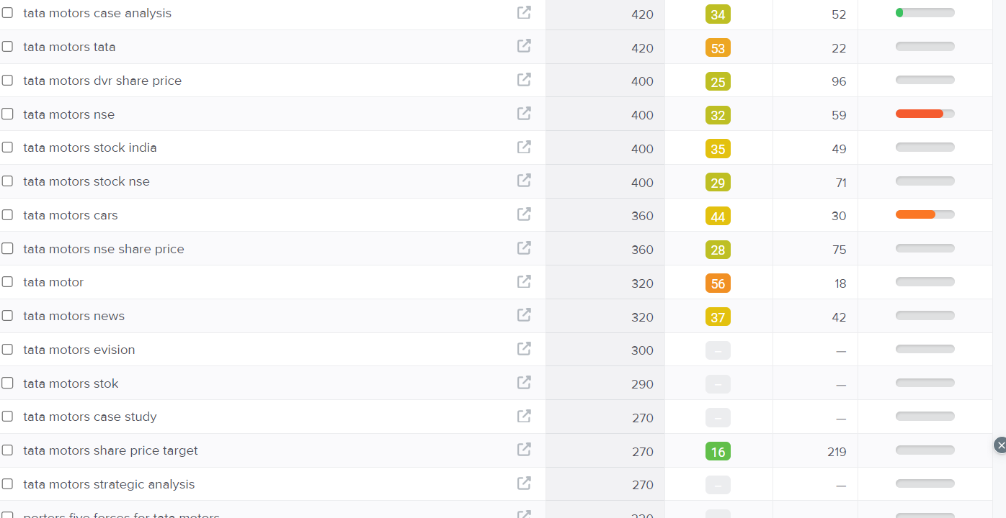
Keyword research

Slide 13
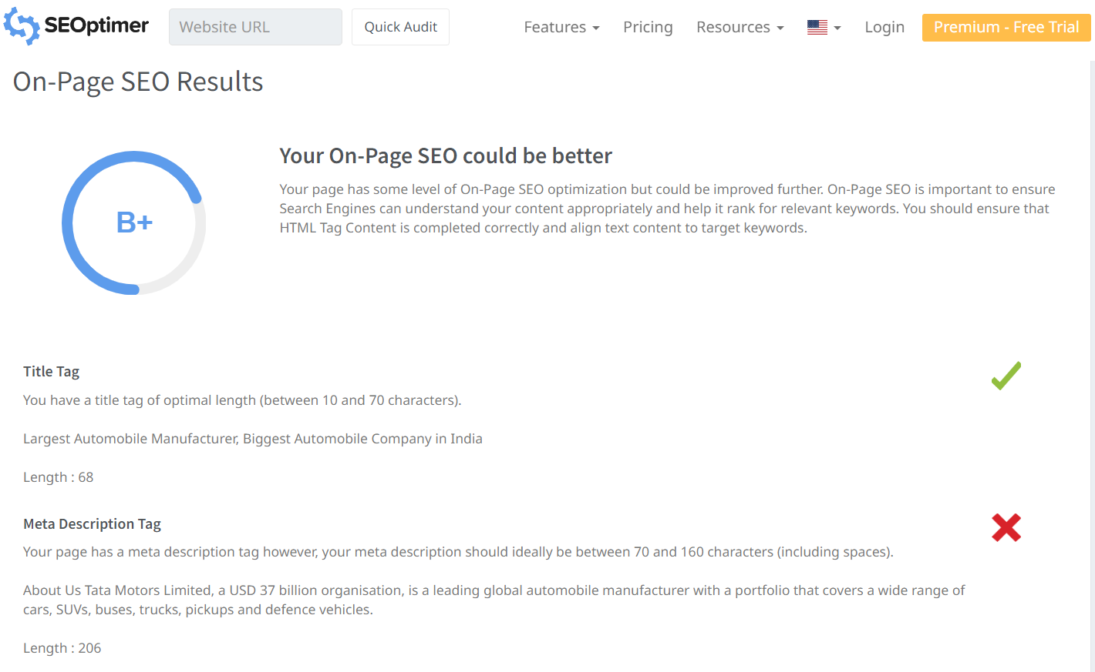
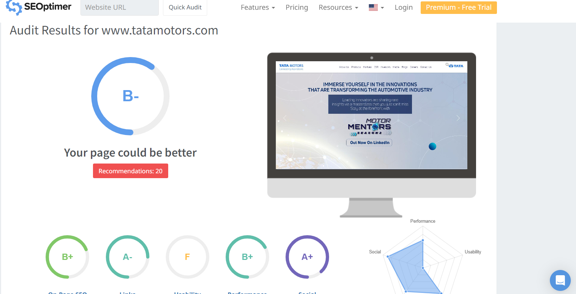
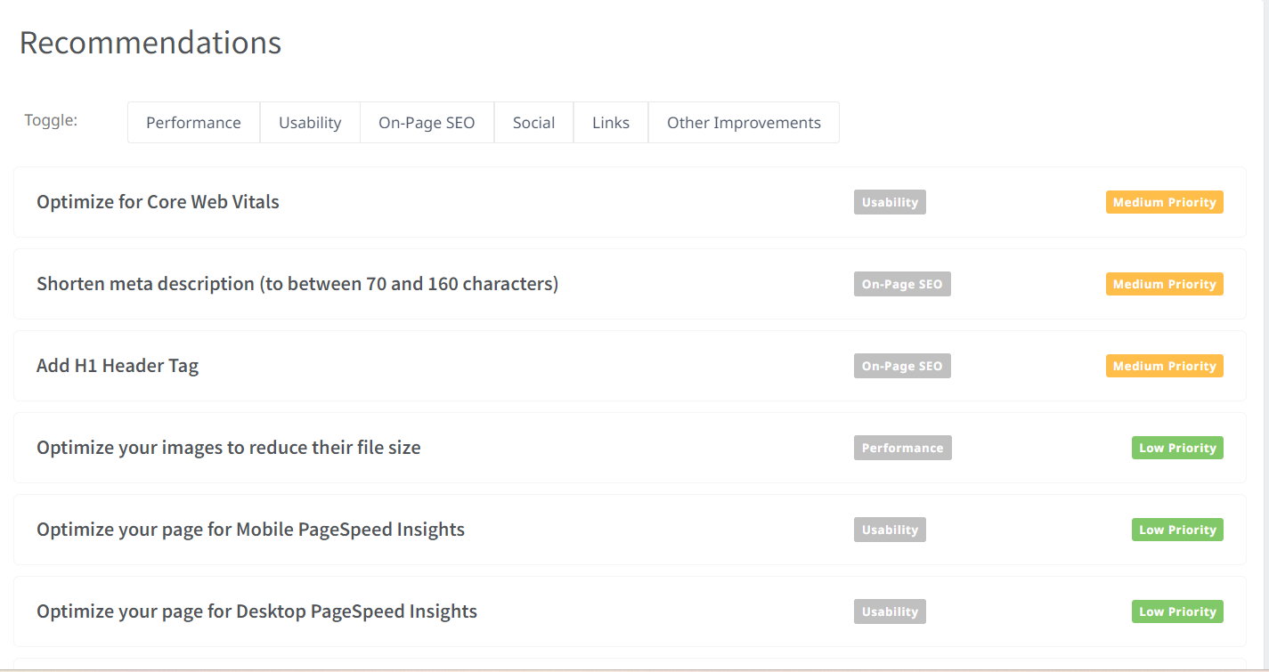
Aduit report

Slide 14

Content creation and curation
Understand your audience
Content strategy
Product information
Storytelling
Social media
Blogging
Video
Visual content
Customer support
Curation
Analytics
consistency

Slide 15
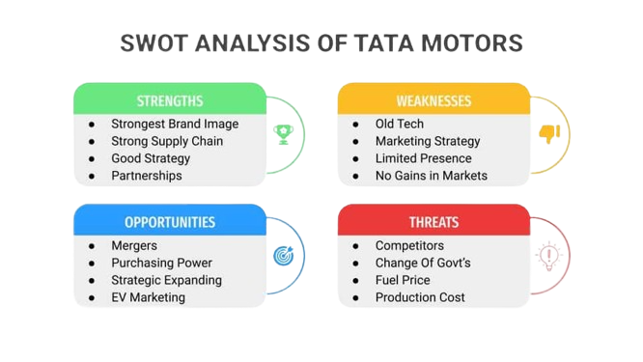

Slide 16
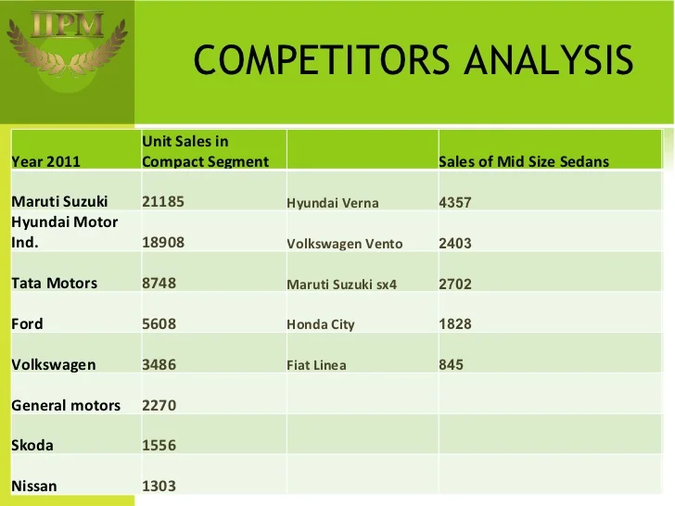

Slide 17

POSTER DESIGN

Slide 18

Instagram reel link
reel:
https://www.instagram.com/reel/CydYG9FLIY4/?igshid=MzRlODBiNWFlZA==
Account:
https://instagram.com/tatamotors393?igshid=OGQ5ZDc2ODk2ZA==

Slide 19
TEAM ROLES AND CONTRIBUTION
Me and my team had done a power point presentation we have divided the work equally, so now I will explain about how we divided the project and how we all participated as a part of team. We are providing this information in certain social network blogs and some other mediums of promotions that is,
A.Tejaswini (TEAM LEADER)
Digital Marketing
Company Brand
Company Stratagies
Brand Stratagies

Slide 20
B.Lokesh
(Created Instagram Account)
Seo and Keyword Reasearch
Reel Creator
B.Diwakar
Content Creation
Curation
Swot Analysis
G.Harinadh Sahu
Poster Designing
Aduit Report
Conclusion
V.Raja Kumar
Introduction
History And Background

Slide 21
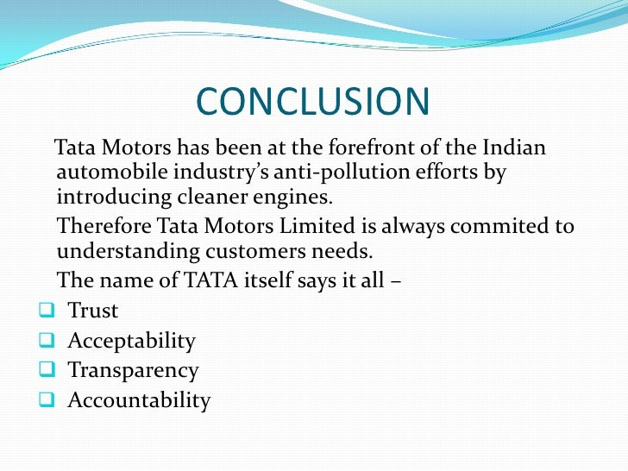
Notes:
Image source: https://www.slideshare.net/kena65/tata-motors-1-1

Slide 22



